Slide 1
FLOW PROPERTIES OF POWDERS

Slide 2
Powders may be free-flowing or cohesive (Sticky).
Many common manufacturing problems are attributes to powder flow.
Powder transfer through large equipment such as hopper.
Uneven powder flow → excess entrapped air within powders → capping or lamination.
Uneven powder flow → increase particle’s friction with die wall causing lubrication problems and increase dust contamination risks during powder transfer.

Slide 3
Powder storage, which for example result in caking tendencies within a vial or bag after shipping or storage time.
Separation of small quantity of the powder from the bulk-specifically just before the creation of individual doses such as during tableting, encapsulation and vial filling which affect the weight uniformity of the dose (under or over dosage).

Slide 4
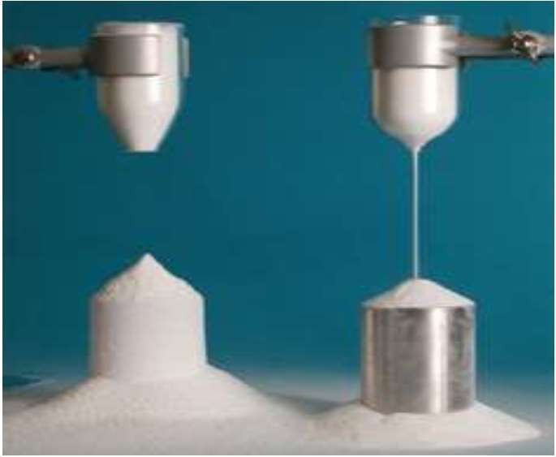
Powder flow problems

Slide 5
Tests to evaluate the flowability of a powder.
Carr’s compressibility index.
Hausner ratio.
The angle of repose (θ).

Slide 6
Carr’s compressibility index
A volume of powder is filled into a graduated glass cylinder and repeatedly tapped for a known duration. The volume of powder after tapping is measure.
Tapped density - Poured or bulk density
Carr’s index (%) = Tapped density
Bulk density= weight/bulk volume Tapped density=weight/true volume
X 100

Slide 7
Carr’s compressibility index
Relationship between powder flowability and % compressibility
Flow description | % Compressibility
Excellent flow | 5 – 15
Good | 16 – 18
Fair | 19 – 21
Poor | 22 – 35
Very Poor | 36 -40
Extremely poor | > 40

Slide 8
Hausner ratio
Tapped density
Hausner ratio =
Poured or bulk density
Hausner ratio was related to interparticle friction:
Value less than 1.25 indicates good flow (=20% Carr).

Slide 9
Hausner ratio
The powder with low interparticle friction, such as coarse spheres.
Value greater than 1.5 indicates poor flow (= 33% Carr’s Compressibility Index)).
More cohesive, less free-flowing powders such as flakes.
Between 1.25 and 1.5 added glidant improves flow.
> 1.5 added glidant doesn’t improve flow.
normally

Slide 10
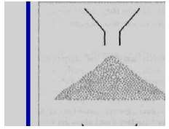
The angle of repose (θ)
The sample is poured onto the horizontal surface and the angle of the resulting pyramid is measured.
The user normally selects the funnel orifice through which the powder flows slowly and reasonably constantly.

Slide 11
The angle of repose (θ)
Angle of repose less than 20 (Excellent flow).
Angle of repose between20-30 (Good flow).
Angle of repose between 30-40 (Pass flow).
Angle of repose greater than 40 (Poor flow).
The rougher and more irregular the surface of the particles, the higher will be the angle of repose.

Slide 12
Factors affecting the flow properties of powder
Improvement
of
Powder Flowabilty
Particle’s size & Distribution
Particle Shape & texture
Surface forces
Flow Activators

Slide 13
Factors affecting the flow properties of powder
Alteration of Particle’s size & Distribution
Alteration of Particle shape & texture
Alteration of Surface Forces
Formulation additives (Flow activators)

Slide 14
Factors affecting the flow properties of powder
Alteration of Particle’s size & Distribution
There is certain particle size at which powder’s flow ability is optimum.
Coarse particles are more preferred than fine ones as they are less cohesive.
The size distribution can also be altered to improve flowability by removing a proportion of the fine particle fraction or by increasing the proportion of coarser particle’s such as occurs in granulation.

Slide 15
Factors affecting the flow properties of powder
Alteration of Particle shape & texture
Particle’s Shape
Generally, more spherical particles have better flow properties than more irregular particles.
Spherical particles are obtained by spray drying, or by temperature cycling crystallization.

Slide 16
Factors affecting the flow properties of powder
Alteration of Particle shape & texture Particle’s texture
Particles with very rough surfaces will be more cohesive and have a greater tendency to interlock than smooth surfaced particles.

Slide 17
Factors affecting the flow properties of powder
Alteration of Surface Forces
Reduction of electrostatic charges can improve
flowability.
powder
Electrostatic charges can be reduced by altering process conditions to reduce frictional contacts.
Moisture content of particle greatly affects powder’s flowability.
Adsorbed surface moisture films tend to increase bulk density and reduce porosity.
Drying the particles will reduce the cohesiveness and improve the flow.
Hygroscopic powder’s stored and processed under low humidity conditions.

Slide 18
Factors affecting the flow properties of powder
Formulation additives (Flow activators)
Flow activators are commonly referred as a glidants.
Flow activators improve the flowability of powders by reducing adhesion and cohesion.
e. g. Talc, maize starch and magnesium stearate.

Slide 19
THANK YOU

