Slide 1
POWDERS
M. Venkata Swamy
Associte Professor, MLRIP

Slide 2
POWDERS AS A DOSAGE FORM
Powders are prepared either as dusting powders
which are applied locally, dentifrices, products for reconstitution, insufflations and aerosols.

Slide 3
Advantages of Powders as a dosage form:
Flexibility in compounding and good chemical stability.
 Disadvantages of powders as a dosage form:
Time-consuming to prepare
Not suited well for dispensing the unpleasant-tasting or hygroscopic drugs.
Inaccuracy of dose for bulk powders.

Slide 4
The dose is influenced by many factors, including size of
measuring spoon, density of powder, humidity, degree of settling and fluffiness due to agitation.

Slide 5
Preparation of powder dosage forms
SIZE REDUCTION
Reduction of particle size of all ingredients with the
same range to prevent separation of large and small particles.

Slide 6
Trituration
This term refers to the of reducing substances
process to fine
particles by rubbing them in a mortar with a pestle. This results in blending powders and breaking up soft aggregates of powders.
When granular or crystalline
materials are to be
incorporated into a powdered product, these materials are
Department of Pharmaceutics
triturated individually and then blended together in the

Slide 7
Pulverization by Intervention
This is the process of reducing the state of solids with the additional material as volatile solvents which can be removed easily after the pulverization has been completed and the powdered material is obtained.
This technique is applied to substances which are gummy and tend to reagglomerate or which resist grinding.
Example:
Camphor which cannot be pulverized easily by
trituration because of its gummy properties, can be

Slide 8
reduced to a fine powder by the addition of a small amount of alcohol or other volatile solvent.
Iodine crystals can be triturated with the aid of a small
quantity of ether.

Slide 9
Levigation
In this process a paste is first formed by the addition of a suitable non-solvent to the solid material.
Particle-size reduction then is accomplished by robbing the paste in a mortar with a pestle.
Levigation technique is used to incorporate solids into
ointments and suspensions.
Department
of Pharmaceutics

Slide 10
BLENDING (MIXING)
Blending is used when two or more substances are to be
combined to form a uniform powder mixture.
Depending upon the nature of the ingredients and the amount of powder to be prepared mixing may be by spatulation, trituration, sifting, tumbling or by mechanical mixers.
Department of Pharmaceutics

Slide 11
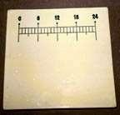
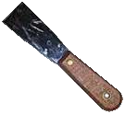
Spatulation
Department of
Pharmaceutics

Slide 12
Trituration
Department of Pharmaceutics

Slide 13
For chemicals that may stain the
porcelain or Wedgewood surface, a glass mortar may be preferred.

Slide 14
When
By this method, the potent drug placed upon an equal volume the diluent
in a mortar and the mixture is mixed by trituration. Then a second portion of diluent equal in volume to the powder mixture in the mortar is added, and the trituration is repeated. This process is continued by
adding equal volumes of diluent to that powder present in the mortar and repeating the mixing until all of the diluent is incorporated.

Slide 15
Sifting
Powders may also be mixed by passing them through
sifters.
This process results in a light fluffy product.
This process is not acceptable
for the incorporation of

Slide 16
potent drugs into a diluent base.

Slide 17
Tumbling
The powder enclosed in a large container which rotates
generally by a motorized process.
Such blenders are widely employed in industry to blend
large amounts of powder.
Department
of Pharmaceutics

Slide 18
PROBLEMS IN POWDER MANUFACTURE
The incorporation of volatile
substances, eutectic mixtures, liquids
and hygroscopic
powders presents
substances
problems
into
that
require special treatments.

Slide 19
Volatile Substances
The loss of camphor, menthol and essential oils by volatilization when incorporated into powders may be prevented or retarded by use of heat-sealed plastic bags or by double wrapping with a waxed or glassine paper inside a bond paper.

Slide 20
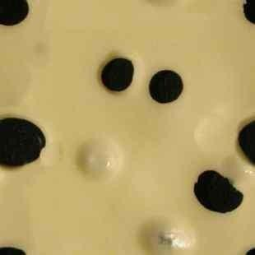
Eutectic Mixtures

Slide 21
prevented eutexia with aspirin, phenyl salicylate.
This technique offers the advantage of extended product stability.

Slide 22
Magnesium carbonate or light magnesium oxide are used commonly as effective diluents for this purpose. An
amount of diluent equal to the eutectic compounds is sufficient to prevent liquefaction for about 2 weeks.
Each eutectic compound should be mixed
first with a
portion of the diluent and gently blended together,
preferably with a spatula on a sheet of paper.

Slide 23
Liquids
Liquids may be incorporated into divided powders.
Magnesium carbonate, starch or lactose may be added to increase the absorbability of the powders if necessary.
When the liquid is a solvent for a nonvolatile heat-stable compound, it may be evaporated gently on a water bath.
Lactose may be added during the evaporation to increase the rate of solvent loss by increasing the surface area. Some extracts and tinctures may be treated in this manner,

Slide 24
although the use of an equivalent amount of a powdered extract is a more desirable technique.

Slide 25
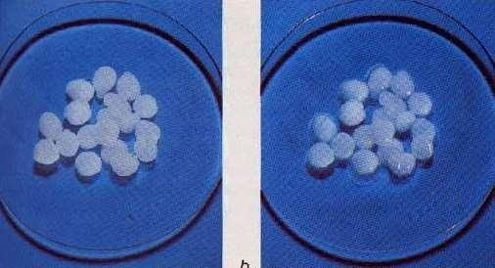
Hygroscopic Substances
Substances that become moist because of affinity for
moisture in the air may be prepared as divided powders by adding inert diluents.
Double-wrapping is desirable for further protection. Extremely Hygroscopic compounds cannot be prepared
as powders.
Department of Pharmaceutics

Slide 26
Use and Packaging of Powders
Depending upon their use, powders are
packaged and dispensed in two main ways:
Bulk powders.
Divided powders.

Slide 27
BULK POWDERS
Example of the bulk powders are:
Oral powders: as antacid and laxative powders, it can be taken by mixing an amount of powder in a portion
of water or other beverage and swallowing as solution or suspension.
Douche powders: generally dissolved in warm water and used as antiseptics or cleansing agents for a body
cavity as for vaginal use.

Slide 28
Douche powders are Dispensed in wide-mouth glass jars serves to protect against air and moisture or loss of volatile materials

Slide 29
Dusting Powders: Medicated or non- medicated for external application for various parts of the body as lubricants, protectives, absorbents, antiseptics, astringents and antiperspirants agents.
Dusting Powders are usually dispensed in sifter containers for convenient application to the skin.
Foot powders and talc powders are currently available as aerosols.
Dentifrices: Dental cleansing powders, used in dental

Slide 30
hygiene.
Denture powders, some used as dentifrices and others
as adhesives to hold the dentures in place.

Slide 31
All powders should be stored in tightly closed containers
for Protection against humidity, air oxidation and loss of
volatile ingredients.
Dispensing powdered drugs in bulk amounts limited to non-potent substances.
Powders containing potent substances or those that
Department of Pharmaceutics
Supplied to the patient in divided amounts.

Slide 32
should be administered in controlled dosage are

Slide 33
DIVIDED POWDERS
After the powder has been mixed, it may be divided into individual doses.
Each divided portion of powder may be placed on a small piece of paper or metal foil which is then folded or in small heat-sealed plastic bags so as to enclose the medication.
Hygroscopic and volatile drugs can be protected by using a waxed paper;

