Slide 1
preservatives in pharmaceutical preparations
Department of Pharmaceutics

Slide 2
Preservatives
Preservatives are substances that are commonly added to various foods and pharmaceutical products in order to prolong their shelf life.

Slide 3
Ideal Properties of Preservatives
1. Non-irritant. 2. non-toxic. 3. stable. 4. compatible with other ingredients used in formulation. 5. good antimicrobial agent and should exert wide spectrum of activity.

Slide 4
6.It must be potent. 7. It should maintain activity throughout product manufacturing, shelf life and usage.
8.not adversely affect patient safety or tolerance of the product.
Department of Pharmaceutics

Slide 5
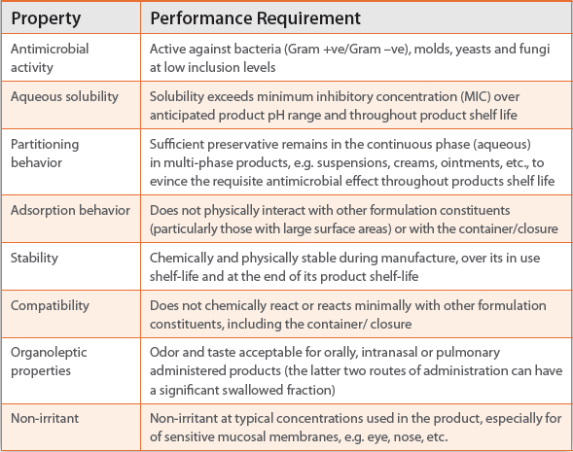
Department of Pharmaceutics

Slide 6
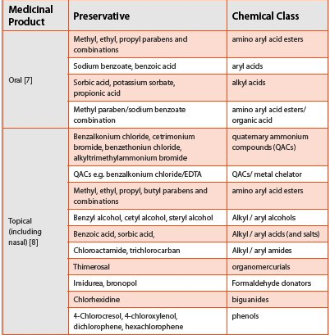
Department of Pharmaceutics

Slide 7
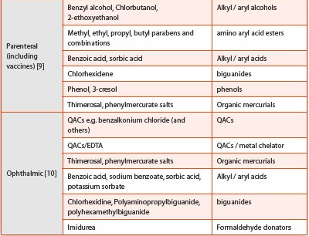
Department of Pharmaceutics

Slide 8
Classification of Preservatives
BASED ON MECHANISM OF ACTION
1.Antioxidants:
Eg. Vitamin E, Vitamin C
Butyl dihydroxy toluene (BHT).
2. Antimicrobial agents:
Eg. Benzoates ,Sorbates
Department of Pharmaceutics

Slide 9
3. Chelating agents:
Eg. Disodium ethylenediamine tetraacetic acid (EDTA)
Polyphosphates
Citric acid

Slide 10
CLASSIFICATION BASED ON SOURCE
Natural Preservatives:
Eg. Neem Oil,Salt (sodium chloride), Lemon, Honey
2. Artificial Preservatives:
Eg. Benzoates, Sodium benzoate, Sorbates, propionets, nitrites.
Department of Pharmaceutics

Slide 11
Factors Affecting the efficacy of Preservatives
Temperature
capacity
Presence of inactivating agents
Concentration
Inoculum Size
product pH

Slide 12
Container and Packaging
Type and Initial Level of Contamination
Chemical Structure of the Preservatives

Slide 13
Test organisms that are recommended by all of the pharmacopoeias include,
Gram positive coccus, Staphylococcus aureus.
Gram negative rod, Pseudomonas aeruginosa.
Fungi / mold, Aspergillus niger.
Yeast, Candida albicans.

Slide 14
Evaluation of microbial stability of formulations:
Contamination occurs from two origins:
during production and filling
during usage
Common test procedures:
screening tests
quantitative tests
Screening tests
Dip slides
Plate count methods

