Slide 1
By
V A N V HARITA
ASSISTANT PROFESSOR
DEPARTMENT
OF
PHARMACEUTICAL CHEMISTRY

Slide 2
Analytical chemistry
Analytical chemistry studies and uses instruments and methods used to separate, identify, and quantify matter. In practice, separation, identification or quantification may constitute the entire analysis or be combined with another method.
Qualitative analysis – identify the chemical constitute
Quantitative analysis – determines the quantity of constitute

Slide 3
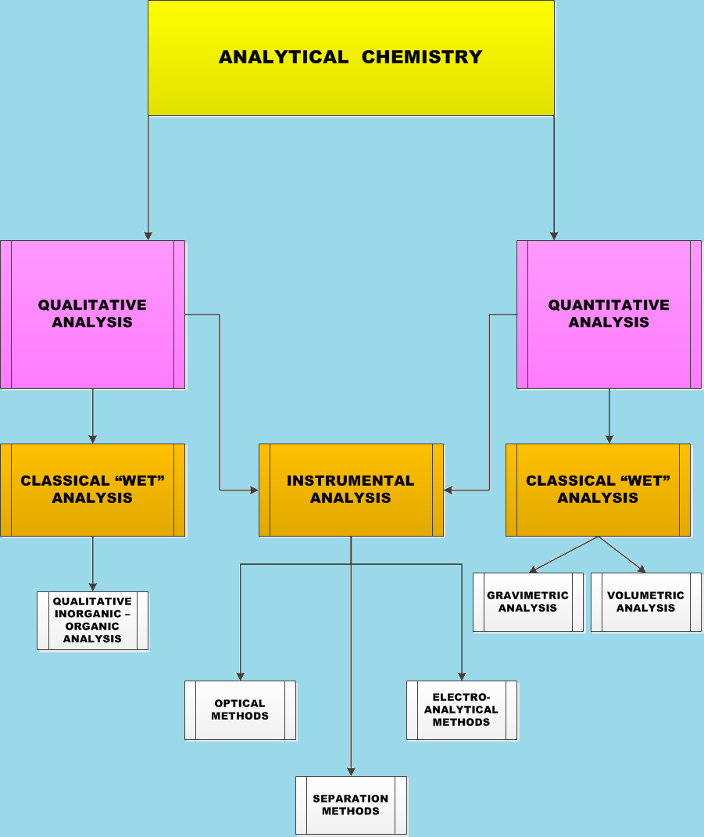

Slide 5
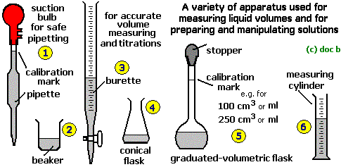
Requirements

Slide 6
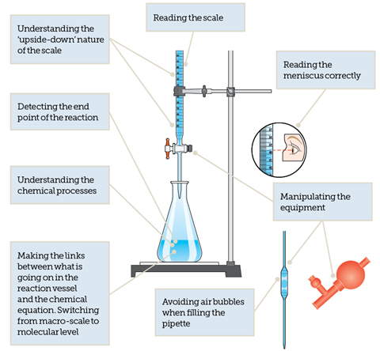

Slide 7
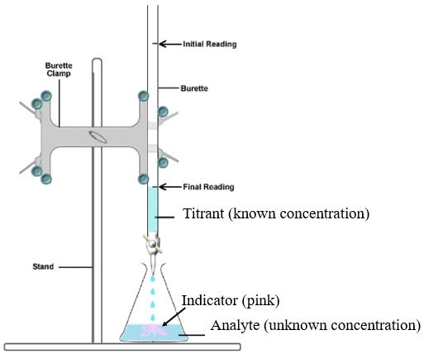

Slide 11
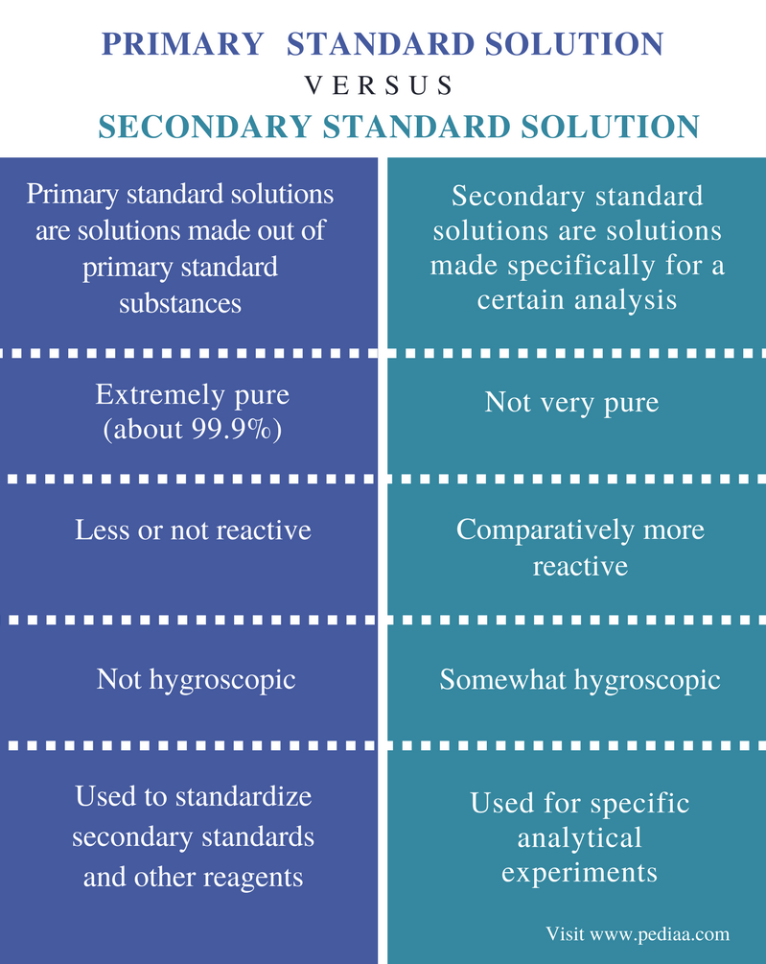

Slide 12
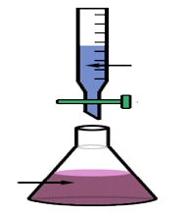
ASSAY of NH4Cl
STANDARDIZATION
TITRANT
NaOH ---- SECONDARY STANDARD SOLUTION
NaOH ---- SECONDARY STANDARD SOLUTION
ANALYTE/ TITRAND
NH4Cl
HCHO
Phenopthalein
Potassium Hydrogen Pthalate ---- PRIMARY STANDARD SOLUTION

Slide 13
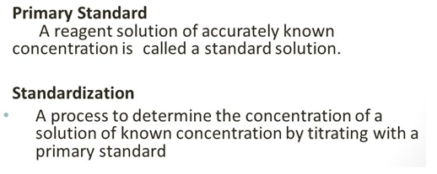
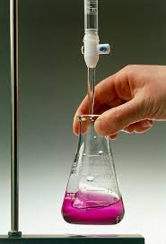
Requirements to carry volumetric analysis
Reaction should between titrant & titrand
Reaction should be one way
Should have knowledge of reactions , reactants & products formed
There should be no side products
Clear end point

Slide 14
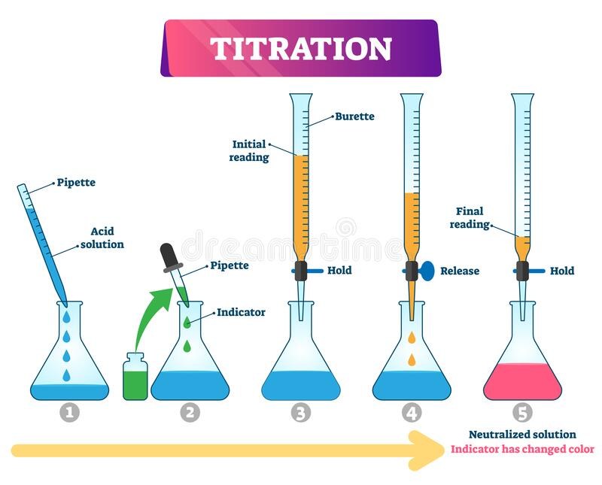

Slide 15
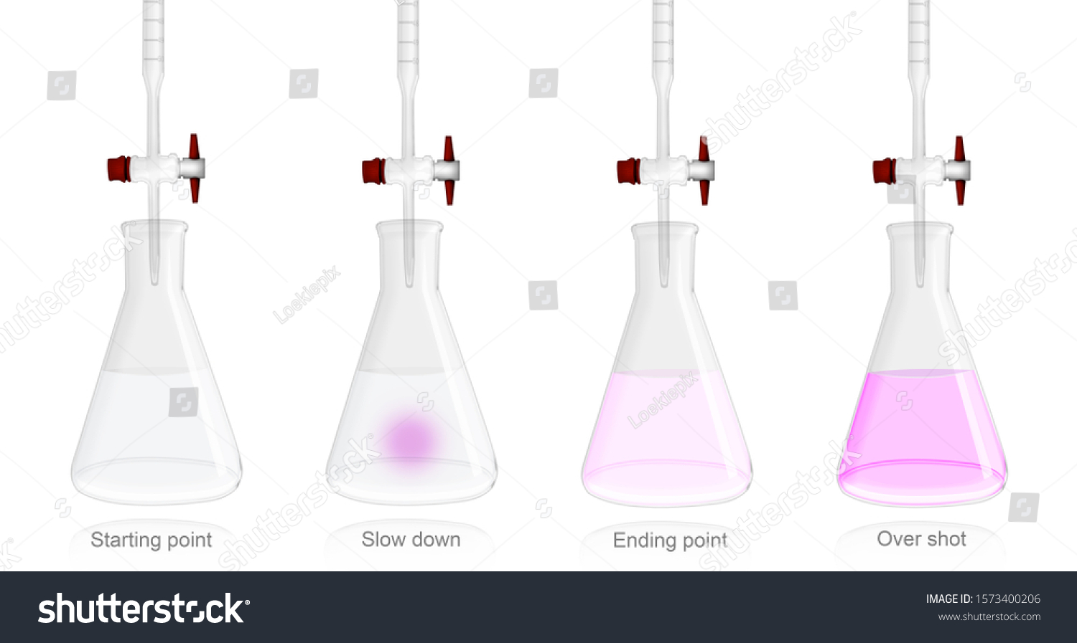

Slide 17
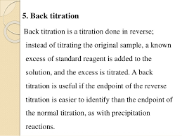

Slide 18
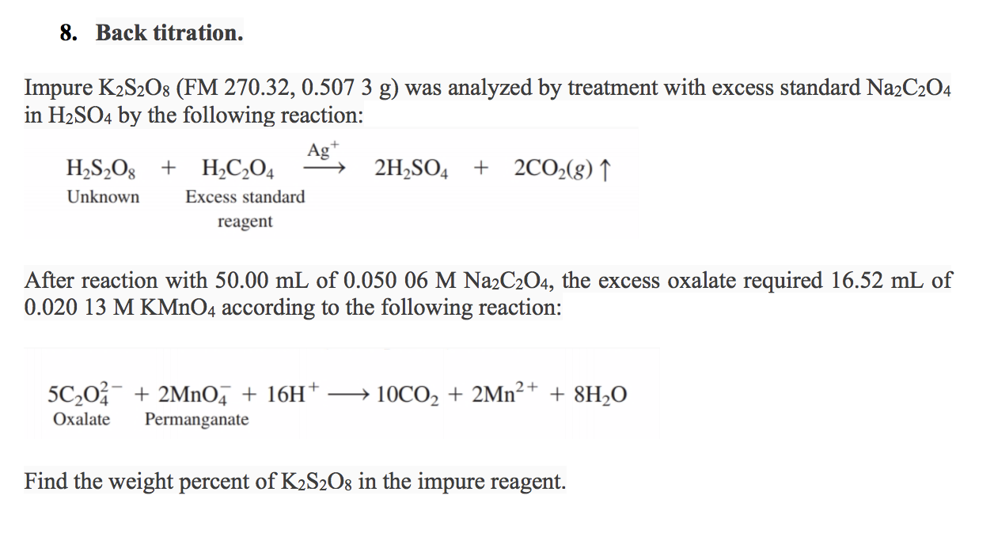

Slide 20
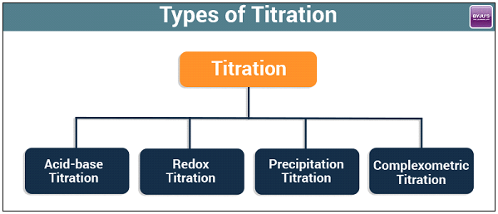

Slide 24
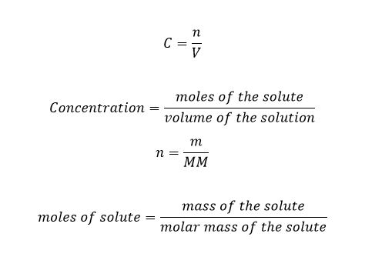
Concentration

Slide 26
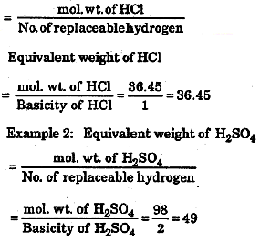

Slide 27
NaOH

Slide 29
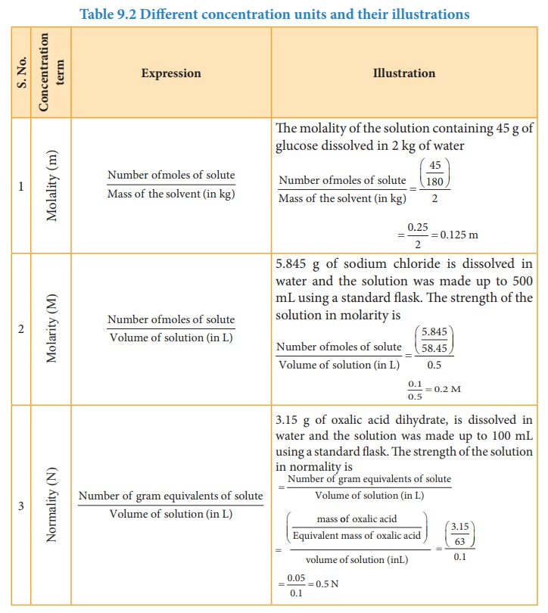
Method of Expressing Concentration

Slide 30
Weight
Molecular weight
Volume
Mole

Slide 31
Eq Wt = Wt/no of replaceable H+
126/2= 63
Weight
E Wt
Volume
Gram Eq Wt

Slide 32
Weight
Mol wt
mass
Moles

Slide 33
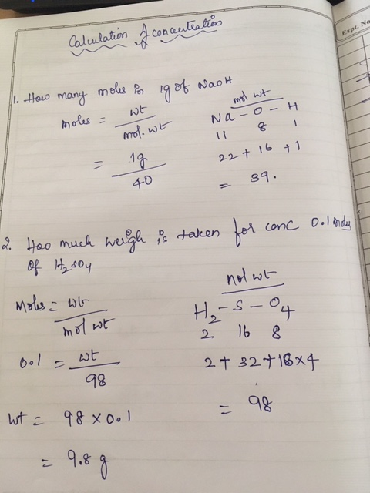

Slide 34
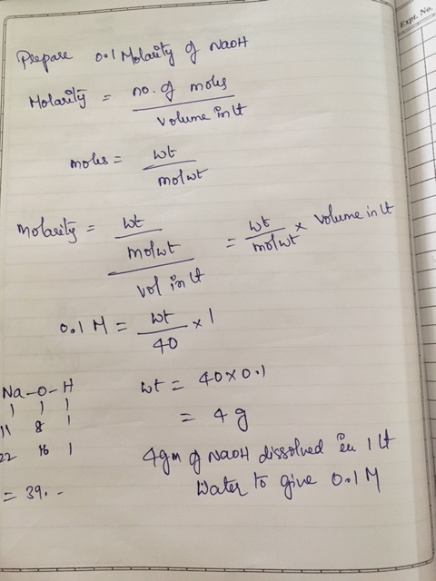

Slide 35
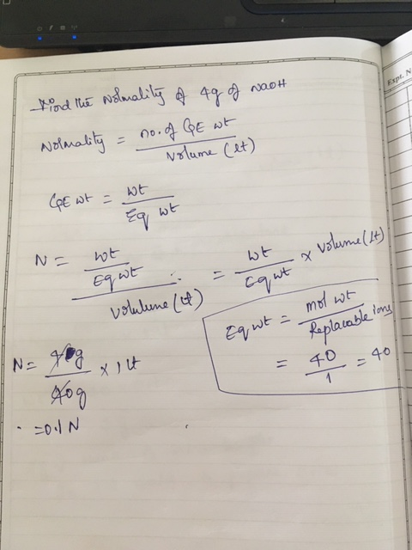

Slide 36
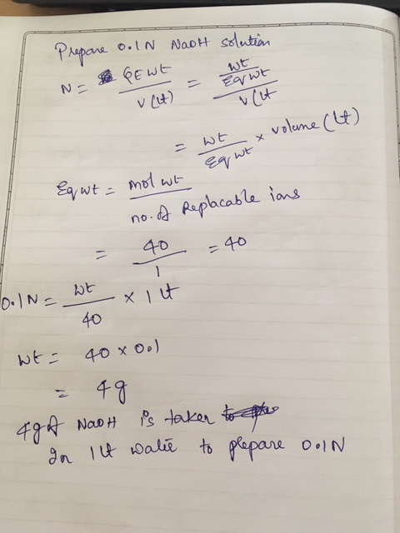

Slide 37
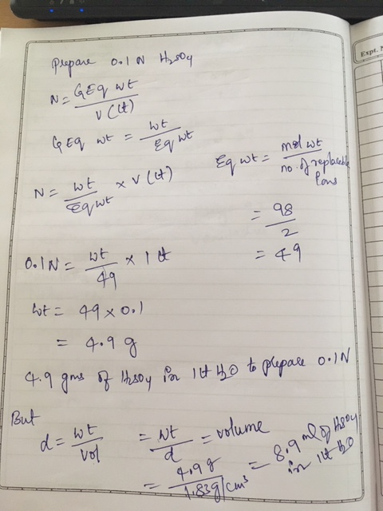

Slide 38
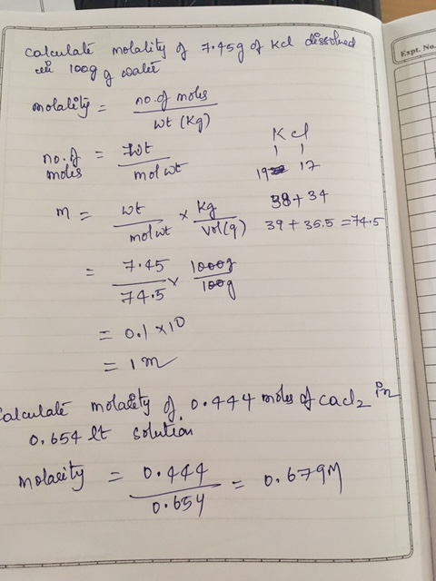

Slide 39
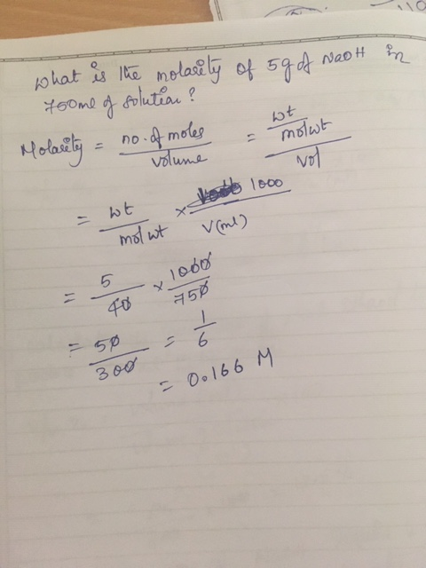

Slide 41
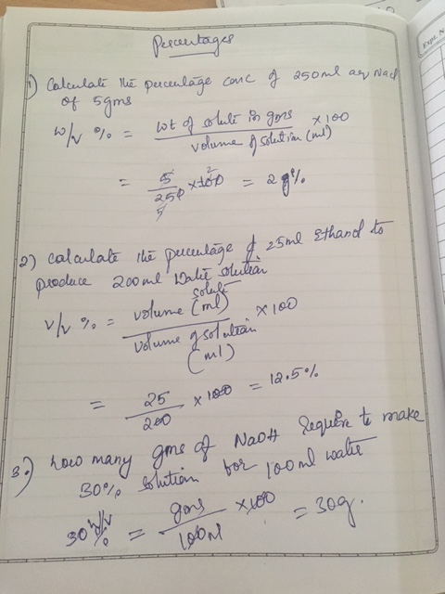

Slide 42
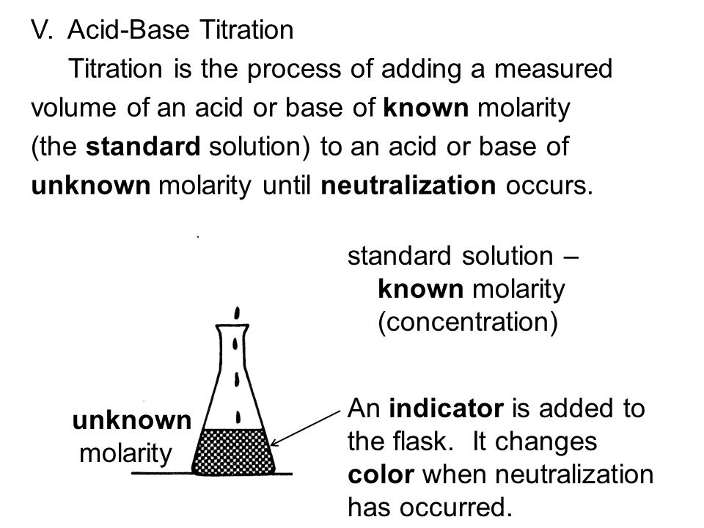

Slide 47
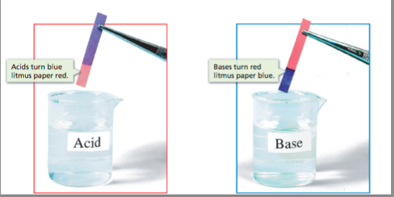

Slide 54
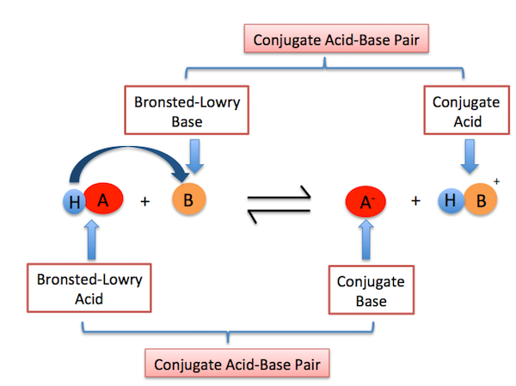

Slide 58
The relative strengths of acids may be quantified by measuring their equilibrium constants in aqueous solutions.
In solutions of the same concentration, stronger acids ionize to a greater extent, and so yield higher concentrations of hydronium ions than do weaker acids.
The equilibrium constant for an acid is called the acid-ionization constant, K_{a}.
For the reaction of an acid HA:
HA(aq) + H2O(l) ⇌ H3O+(aq) + A−(aq),
the acid ionization constant is written
Ka=[H3O+][A−]
[HA]
The larger the K_{a} of an acid, the larger the concentration of H3O+ and A⁻ relative to the concentration of the nonionized acid, HA, in an equilibrium mixture, and the stronger the acid.
An acid is classified as “strong” when it undergoes complete ionization,
Acids that are partially ionized are called “weak,”

Slide 59
Another measure of the strength of an acid is its percent ionization.
The percent ionization of a weak acid is defined in terms of the composition of an equilibrium mixture:
% ionization = [H3O+]eq ×100%
[HA]0

Slide 60
the relative strength of a base is reflected in the magnitude of its base-ionization constant (K_{b}) in aqueous solutions.
In solutions of the same concentration, stronger bases ionize to a greater extent, and so yield higher hydroxide ion concentrations than do weaker bases.
A stronger base has a larger ionization constant than does a weaker base. For the reaction of a base, B:
B(aq) + H2O(l) ⇌ HB+(aq) + OH−(aq),
the ionization constant is written as
Kb=[HB+] [OH−]
[B]

Slide 61
Type | Examples
Strong Acids | hydrochloric acid (HCl), sulfuric acid (H_{2}2​start subscript, 2, end subscriptSO_{4}4​start subscript, 4, end subscript), nitric acid (HNO_{3}3​start subscript, 3, end subscript)
Weak Acids | acetic acid (CH_{3}3​start subscript, 3, end subscriptCOOH), hydrofluoric acid (HF), oxalic acid (COOH)_{2}2​start subscript, 2, end subscript
Strong Bases | sodium hydroxide (NaOH), potassium hydroxide (KOH), lithium hydroxide (LiOH)
Weak Bases | ammonium hydroxide (NH_{4}4​start subscript, 4, end subscriptOH), ammonia (NH_{3}3​start subscript, 3, end subscript)

Slide 64
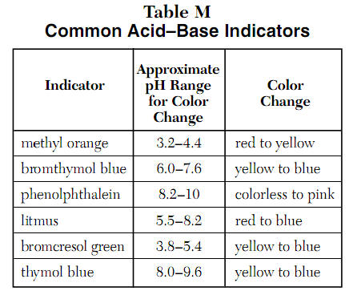

Slide 67
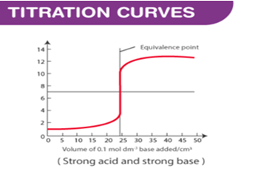

Slide 68
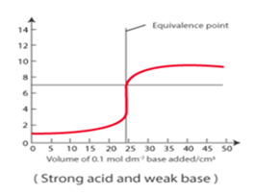

Slide 69
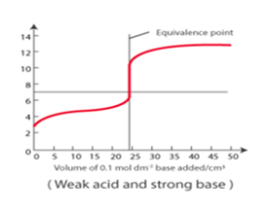

Slide 70
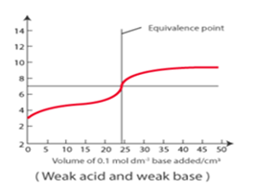

Slide 71
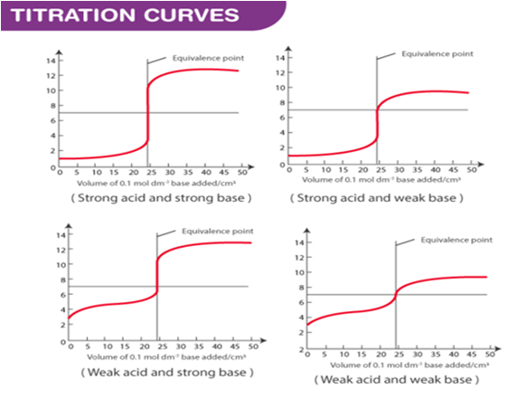

Slide 72
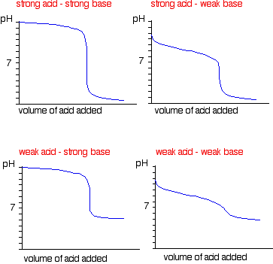

Slide 75
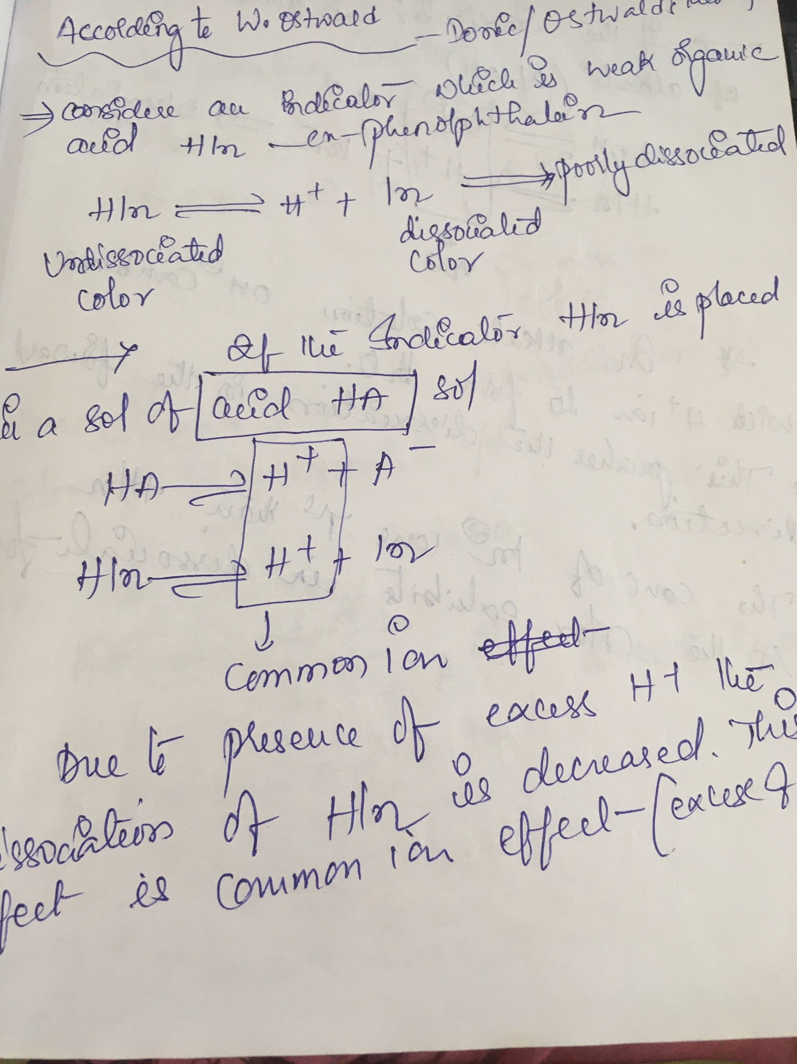

Slide 76
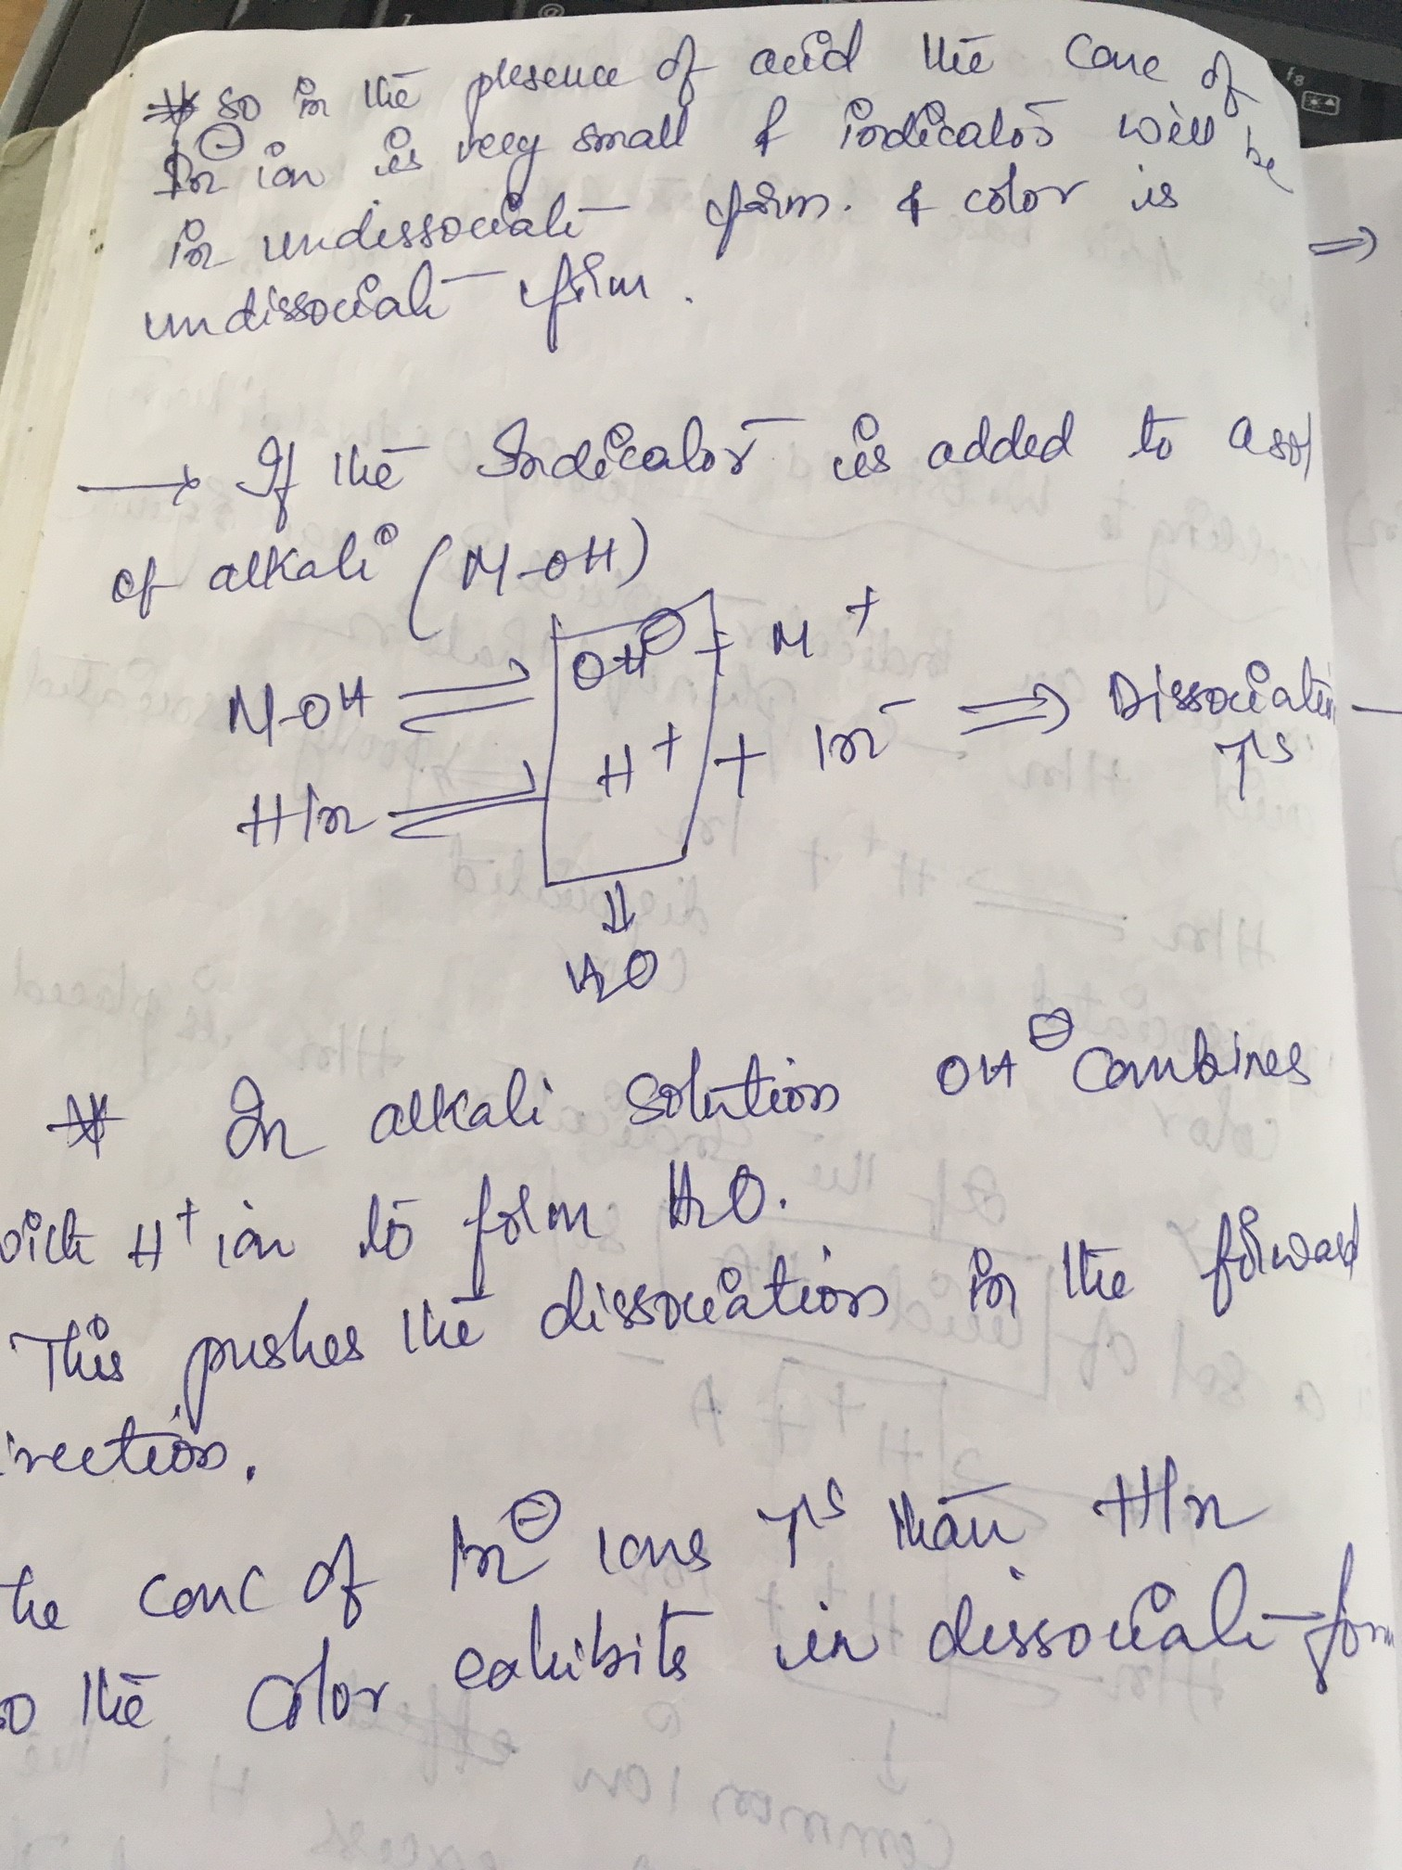

Slide 77
